Slide 1
6
Functions and an Introduction to Recursion

Slide 2
OBJECTIVES
In this chapter you will learn:
To construct programs modularly from functions.
To use common math functions available in the C++ Standard Library.
To create functions with multiple parameters.
The mechanisms for passing information between functions and returning results.
How the function call/return mechanism is supported by the function call stack and activation records.
To use random number generation to implement game-playing applications.
How the visibility of identifiers is limited to specific regions of programs.
To write and use recursive functions, i.e., functions that call themselves.

Slide 3
6.1 Introduction
6.2 Program Components in C++
6.3 Math Library Functions
6.4 Function Definitions with Multiple Parameters
6.5 Function Prototypes and Argument Coercion
6.6 C++ Standard Library Header Files
6.7 Case Study: Random Number Generation
6.8 Case Study: Game of Chance and Introducing enum
6.9 Storage Classes
6.10 Scope Rules
6.11 Function Call Stack and Activation Records
6.12 Functions with Empty Parameter Lists

Slide 4
6.13 Inline Functions
6.14 References and Reference Parameters
6.15 Default Arguments
6.16 Unary Scope Resolution Operator
6.17 Function Overloading
6.18 Function Templates
6.19 Recursion
6.20 Example Using Recursion: Fibonacci Series
6.21 Recursion vs. Iteration
6.22 (Optional) Software Engineering Case Study: Identifying Class Operations in the ATM System
6.23 Wrap-Up

Slide 5
6.1 Introduction
Divide and conquer technique
  Construct a large program from small, simple pieces (e.g., components)
Functions
  Facilitate the design, implementation, operation and maintenance of large programs
C++ Standard Library math functions

Slide 6
6.2 Program Components in C++
C++ Standard Library
  Rich collection of functions for performing common operations, such as:
    Mathematical calculations
    String manipulations
    Character manipulations
    Input/Output
    Error checking
  Provided as part of the C++ programming environment

Slide 7
6.3 Math Library Functions
Global functions
  Do not belong to a particular class
  Have function prototypes placed in header files
    Can be reused in any program that includes the header file and that can link to the function’s object code
  Example: sqrt in <cmath> header file
    sqrt( 900.0 )
    All functions in <cmath> are global functions

Slide 8
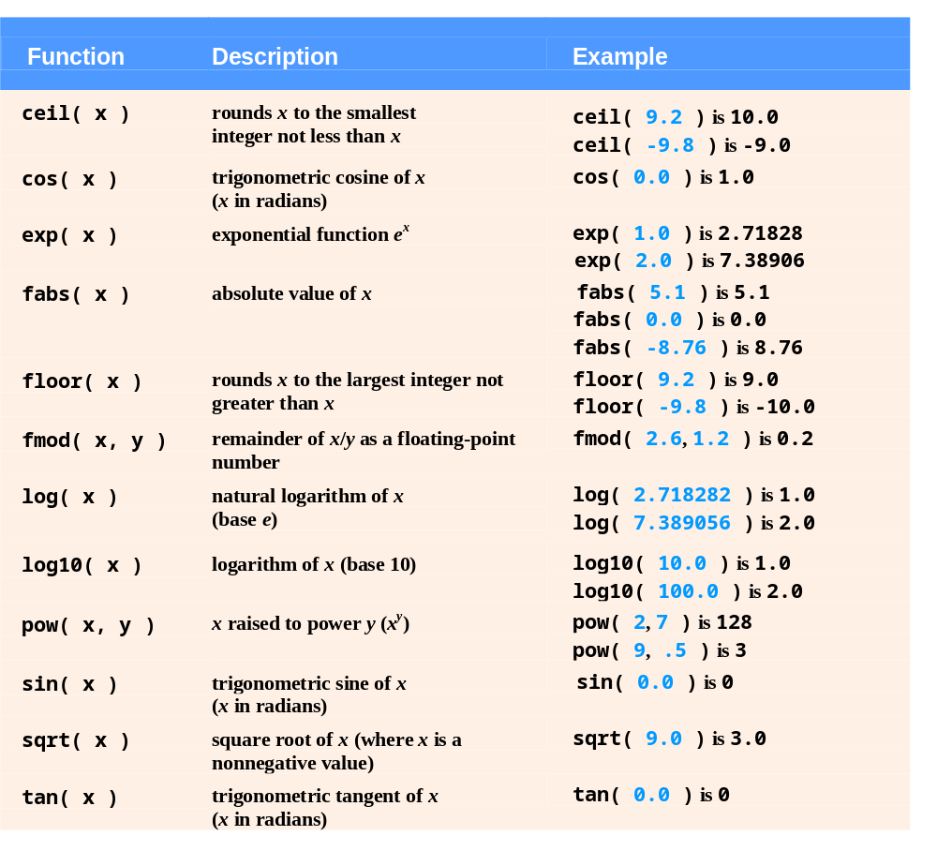
Fig. 6.2 | Math library functions.

Slide 9
6.5 Function Prototypes and Argument Coercion
Function prototype
  Also called a function declaration
  Indicates to the compiler:
    Name of the function
    Type of data returned by the function
    Parameters the function expects to receive
      Number of parameters
      Types of those parameters
      Order of those parameters

Slide 10
6.5 Function Prototypes and Argument Coercion (Cont.)
Function signature (or simply signature)
  The portion of a function prototype that includes the name of the function and the types of its arguments
    Does not specify the function’s return type
  Functions in the same scope must have unique signatures
    The scope of a function is the region of a program in which the function is known and accessible

Slide 11
6.5 Function Prototypes and Argument Coercion (Cont.)
Argument Coercion
  Forcing arguments to the appropriate types specified by the corresponding parameters
    For example, calling a function with an integer argument, even though the function prototype specifies a double argument
      The function will still work correctly

Slide 12
6.5 Function Prototypes and Argument Coercion (Cont.)
C++ Promotion Rules
  Indicate how to convert between types without losing data
  Apply to expressions containing values of two or more data types
    Such expressions are also referred to as mixed-type expressions
    Each value in the expression is promoted to the “highest” type in the expression
      Temporary version of each value is created and used for the expression
        Original values remain unchanged

Slide 13
6.5 Function Prototypes and Argument Coercion (Cont.)
C++ Promotion Rules (Cont.)
  Promotion also occurs when the type of a function argument does not match the specified parameter type
    Promotion is as if the argument value were being assigned directly to the parameter variable
  Converting a value to a lower fundamental type
    Will likely result in the loss of data or incorrect values
    Can only be performed explicitly
      By assigning the value to a variable of lower type (some compilers will issue a warning in this case) or
      By using a cast operator

Slide 14
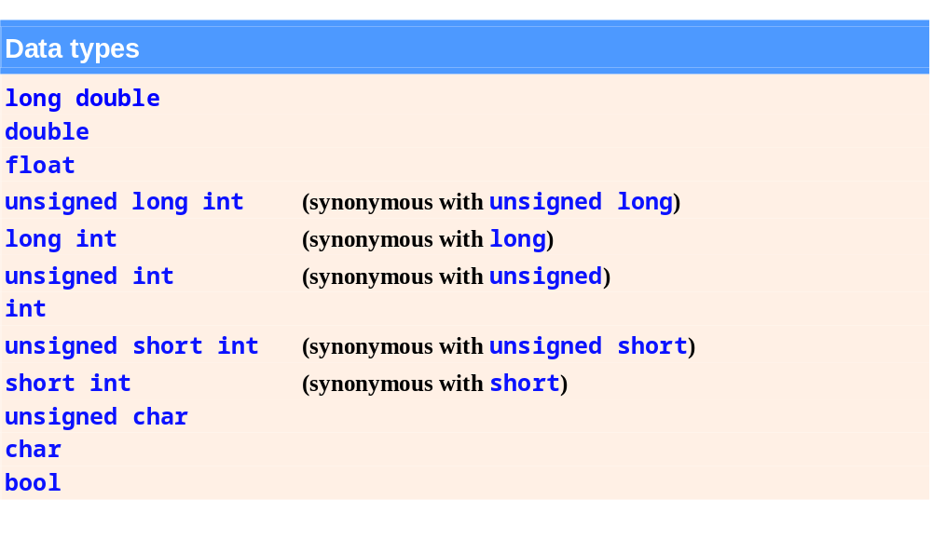
Fig. 6.6 | Promotion hierarchy for fundamental data types.

Slide 15
6.6 C++ Standard Library Header Files
C++ Standard Library header files
  Each contains a portion of the Standard Library
    Function prototypes for the related functions
    Definitions of various class types and functions
    Constants needed by those functions
  “Instruct” the compiler on how to interface with library and user-written components
  Header file names ending in .h
    Are “old-style” header files
    Superseded by the C++ Standard Library header files

Slide 16
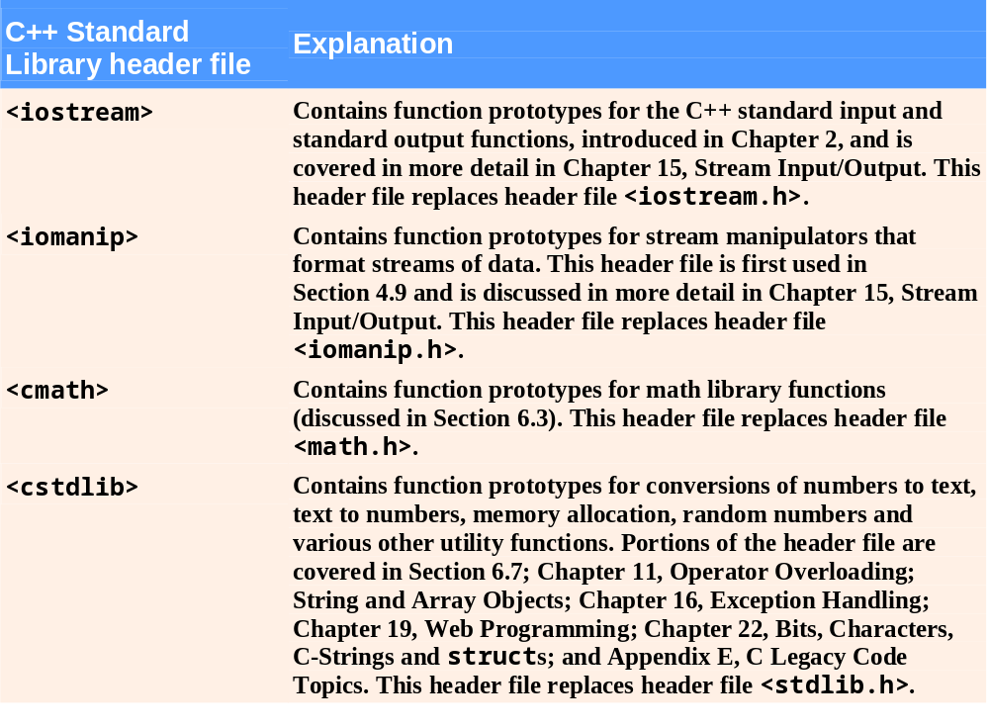
Fig. 6.7 | C++ Standard Library header files. (Part 1 of 4)

Slide 17
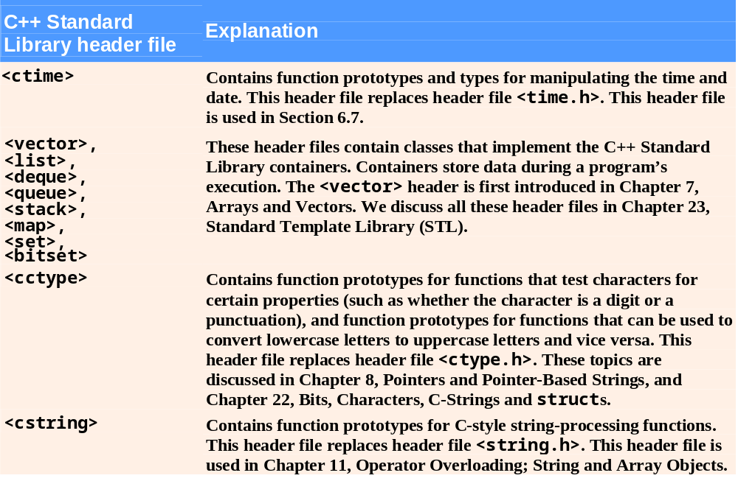
Fig. 6.7 | C++ Standard Library header files. (Part 2 of 4)

Slide 18
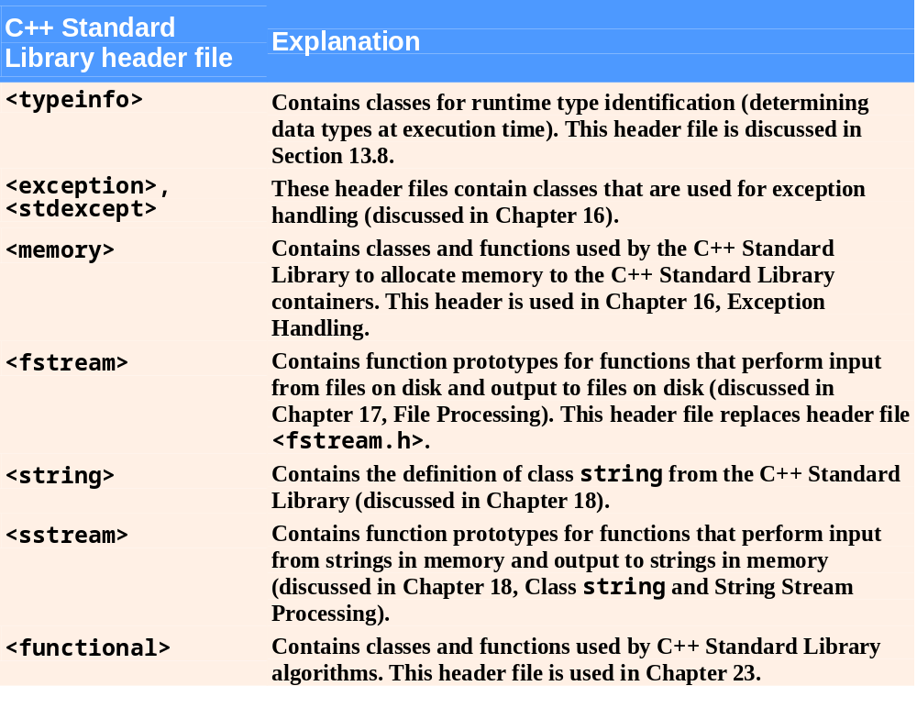
Fig. 6.7 | C++ Standard Library header files. (Part 3 of 4)

Slide 19
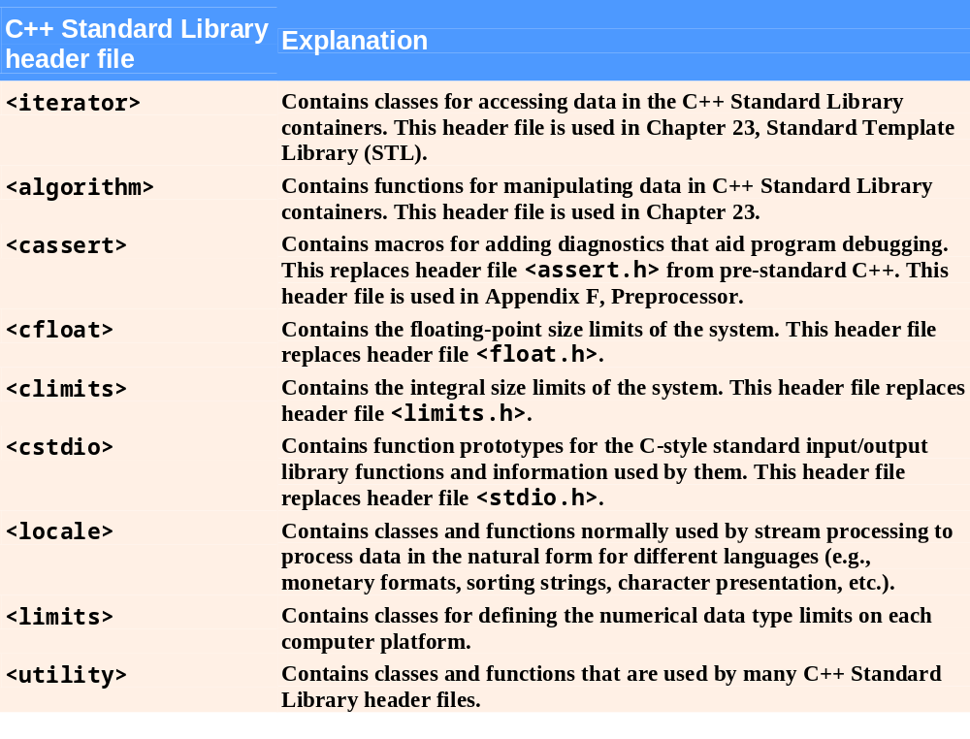
Fig. 6.7 | C++ Standard Library header files. (Part 4 of 4)

Slide 20
6.7 Case Study: Random Number Generation
C++ Standard Library function rand
  Introduces the element of chance into computer applications
  Example
    i = rand();
      Generates an unsigned integer between 0 and RAND_MAX (a symbolic constant defined in header file <cstdlib>)
  Function prototype for the rand function is in <cstdlib>

Slide 21
6.7 Case Study: Random Number Generation (Cont.)
To produce integers in a specific range, use the modulus operator (%) with rand
  Example
    rand() % 6;
      Produces numbers in the range 0 to 5
  This is called scaling, 6 is the scaling factor
  Shifting can move the range to 1 to 6
    1 + rand() % 6;

Slide 22
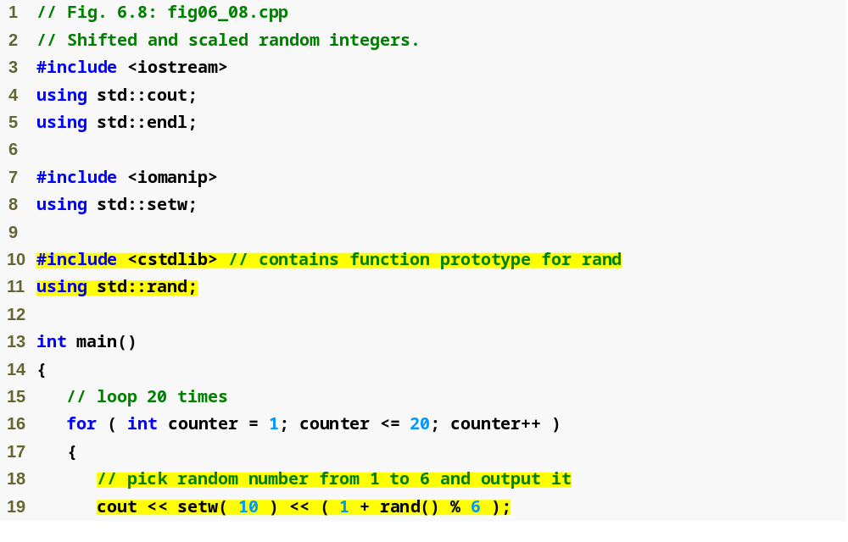
Outline
fig06_08.cpp
(1 of 2)
#include and using for function rand
Calling function rand

Slide 23
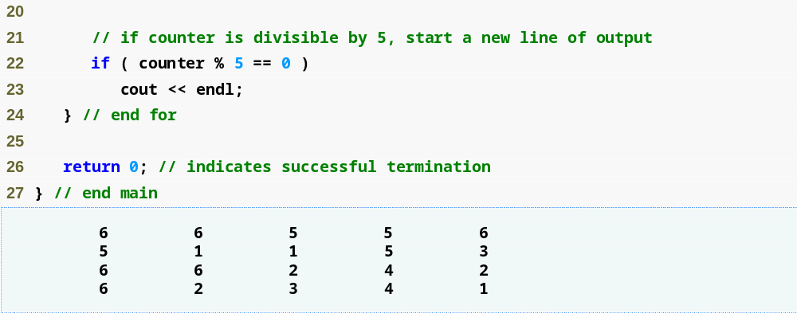
Outline
fig06_08.cpp
(2 of 2)

Slide 24
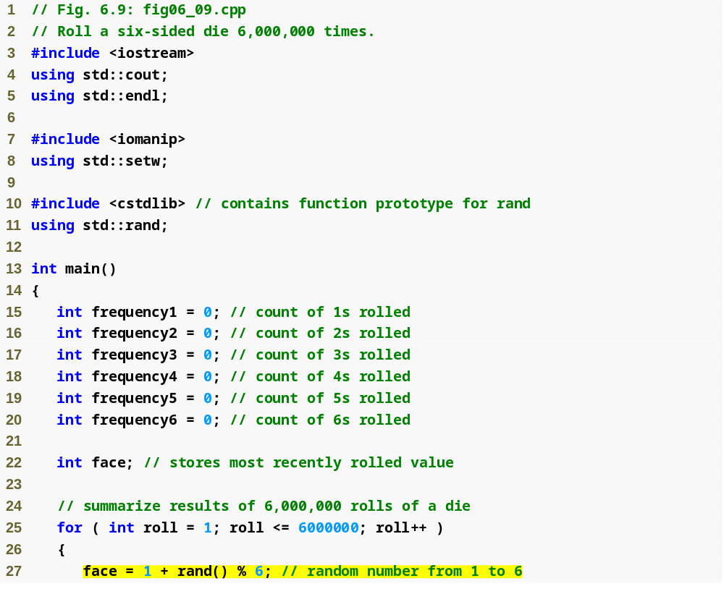
Outline
fig06_09.cpp
(1 of 3)
Scaling and shifting the value produced by function rand

Slide 25
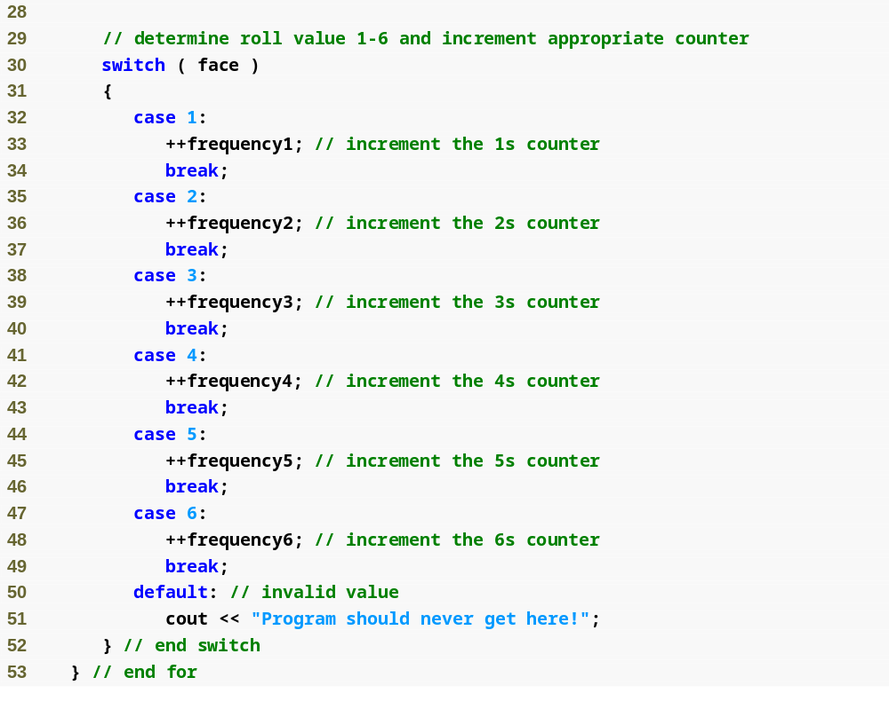
Outline
fig06_09.cpp
(2 of 3)

Slide 26
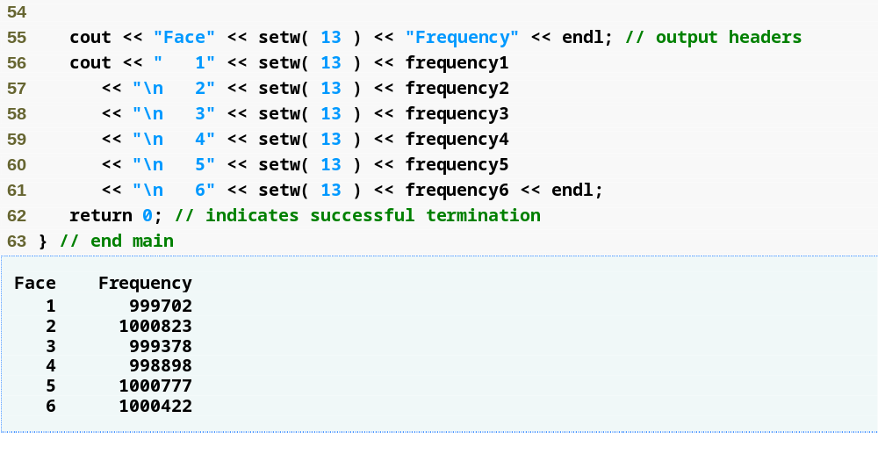
Outline
fig06_09.cpp
(3 of 3)
Each face value appears approximately 1,000,000 times

Slide 27
6.7 Case Study: Random Number Generation (Cont.)
Function rand
  Generates pseudorandom numbers
  The same sequence of numbers repeats itself each time the program executes
Randomizing
  Conditioning a program to produce a different sequence of random numbers for each execution
C++ Standard Library function srand
  Takes an unsigned integer argument
  Seeds the rand function to produce a different sequence of random numbers

Slide 28
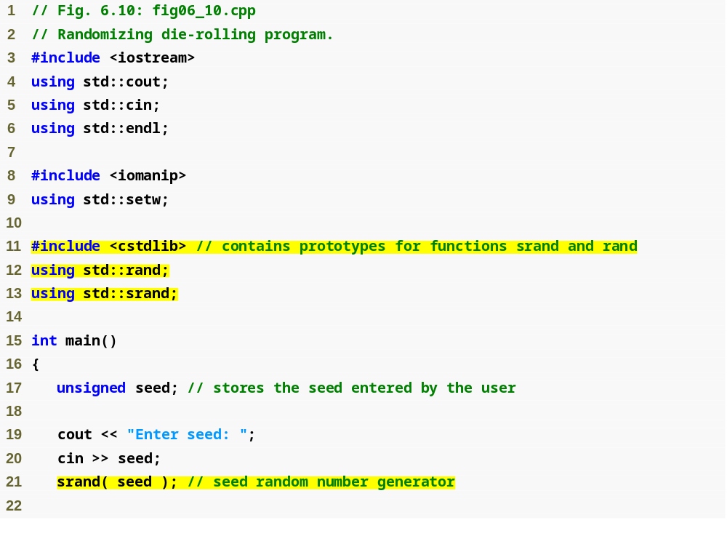
Outline
fig06_10.cpp
(1 of 2)
using statement for function srand
Data type unsigned is short for unsigned int
Passing seed to srand to randomize the program

Slide 29
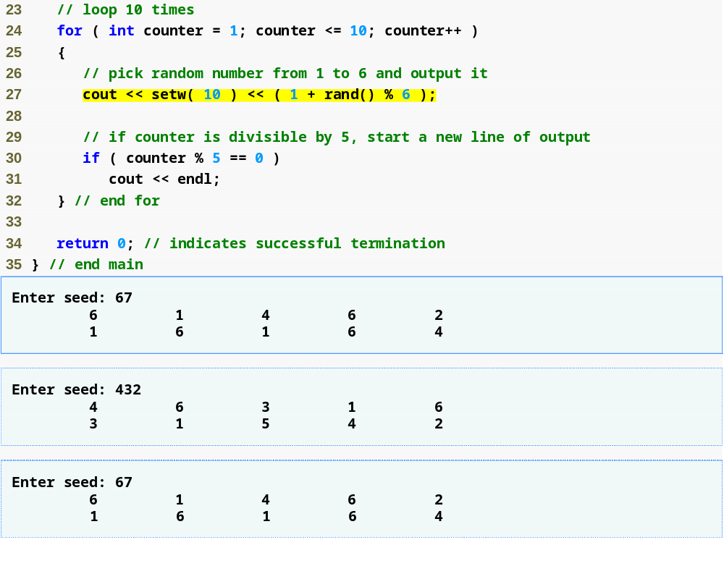
Outline
fig06_10.cpp
(2 of 2)
Program outputs show that each unique seed value produces a different sequence of random numbers

Slide 30
6.7 Case Study: Random Number Generation (Cont.)
To randomize without having to enter a seed each time
  srand( time( 0 ) );
    This causes the computer to read its clock to obtain the seed value
  Function time (with the argument 0)
    Returns the current time as the number of seconds since January 1, 1970 at midnight Greenwich Mean Time (GMT)
    Function prototype for time is in <ctime>

Slide 31
6.7 Case Study: Random Number Generation (Cont.)
Scaling and shifting random numbers
  To obtain random numbers in a desired range, use a statement like
  number = shiftingValue + rand() % scalingFactor;
    shiftingValue is equal to the first number in the desired range of consecutive integers
    scalingFactor is equal to the width of the desired range of consecutive integers
      number of consecutive integers in the range

Slide 32
6.8 Case Study: Game of Chance and Introducing enum
Enumeration
  A set of integer constants represented by identifiers
    The values of enumeration constants start at 0, unless specified otherwise, and increment by 1
    The identifiers in an enum must be unique, but separate enumeration constants can have the same integer value
  Defining an enumeration
    Keyword enum
    A type name
    Comma-separated list of identifier names enclosed in braces
    Example
      enum Months { JAN = 1, FEB, MAR, APR };

Slide 33
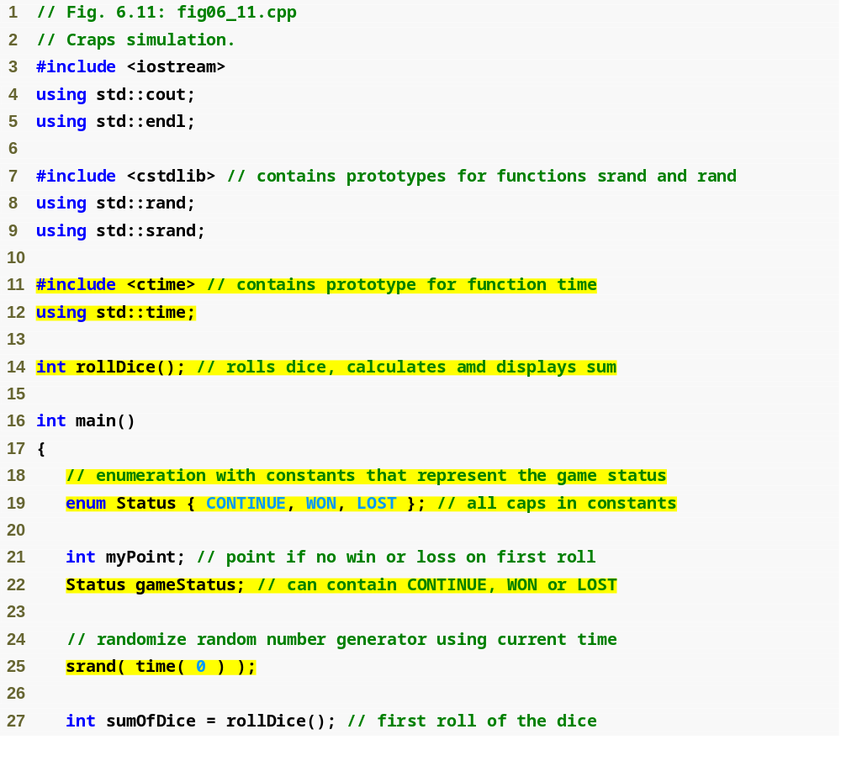
Outline
fig06_11.cpp
(1 of 4)
#include and using for function time
Enumeration to keep track of the game status
Declaring a variable of the user-defined enumeration type
Seeding the random number generator with the current time

Slide 34
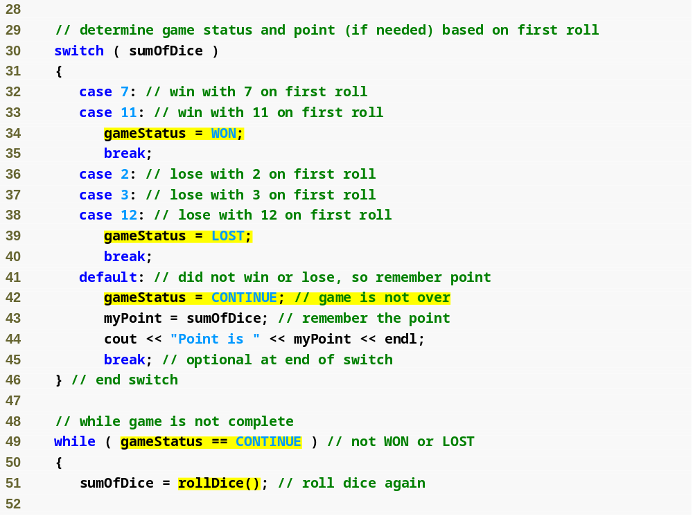
Outline
fig06_11.cpp
(2 of 4)
Assigning an enumeration constant to gameStatus
Comparing a variable of an enumeration type to an enumeration constant

Slide 35
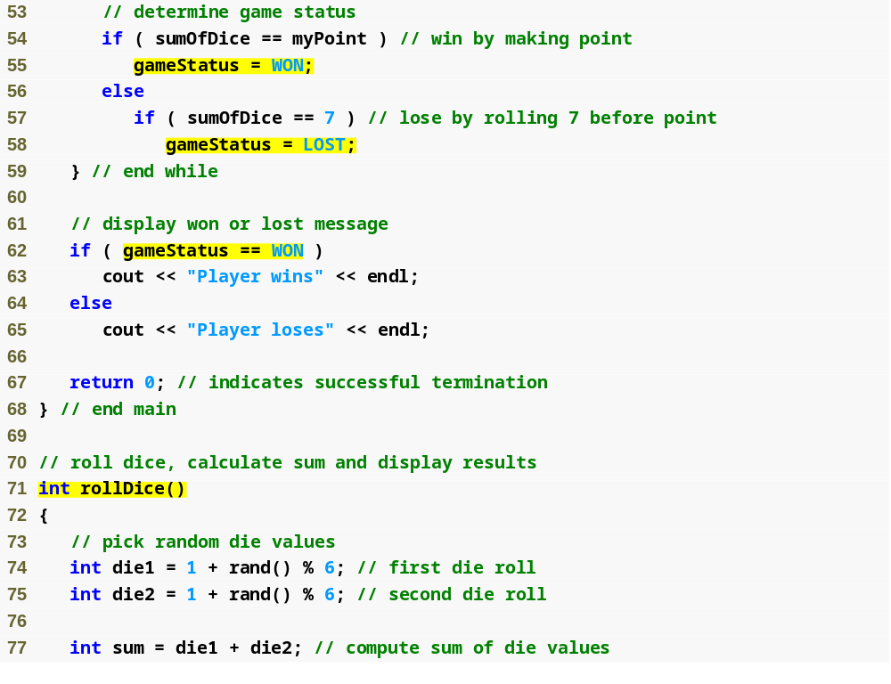
Outline
fig06_11.cpp
(3 of 4)
Function that performs the task of rolling the dice

Slide 36
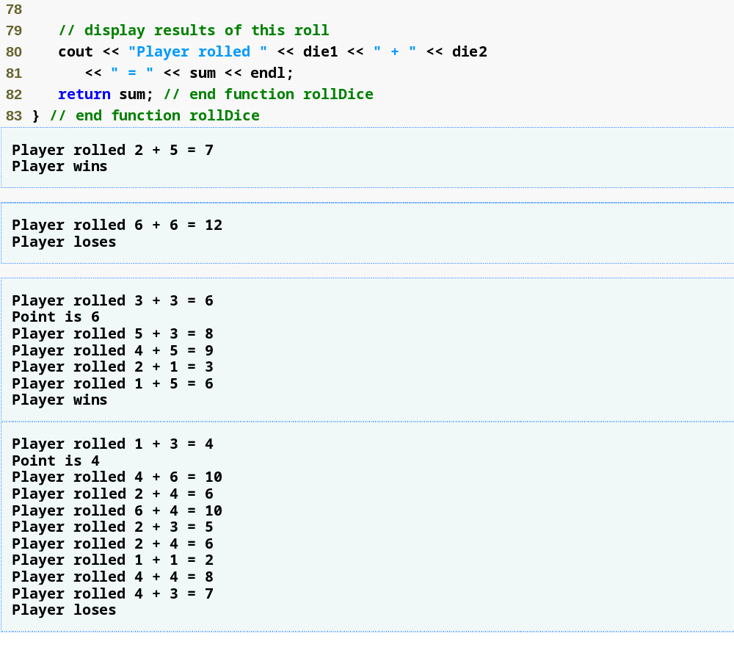
Outline
fig06_11.cpp
(4 of 4)

Slide 37
6.9 Storage Classes
Each identifier has several attributes
  Name, type, size and value
  Also storage class, scope and linkage
C++ provides five storage-class specifiers:
  auto, register, extern, mutable and static
Identifier’s storage class
  Determines the period during which that identifier exists in memory
Identifier’s scope
  Determines where the identifier can be referenced in a program

Slide 38
6.9 Storage Classes (Cont.)
Identifier’s linkage
  Determines whether an identifier is known only in the source file where it is declared or across multiple files that are compiled, then linked together
An identifier’s storage-class specifier helps determine its storage class and linkage

Slide 39
6.9 Storage Classes (Cont.)
Automatic storage class
  Declared with keywords auto and register
  Automatic variables
    Created when program execution enters block in which they are defined
    Exist while the block is active
    Destroyed when the program exits the block
  Only local variables and parameters can be of automatic storage class
    Such variables normally are of automatic storage class

Slide 40
6.9 Storage Classes (Cont.)
Storage-class specifier auto
  Explicitly declares variables of automatic storage class
  Local variables are of automatic storage class by default
    So keyword auto rarely is used
Storage-class specifier register
  Data in the machine-language version of a program is normally loaded into registers for calculations and other processing
    Compiler tries to store register storage class variables in a register
  The compiler might ignore register declarations
    May not be sufficient registers for the compiler to use

Slide 41
6.9 Storage Classes (Cont.)
Static storage class
  Declared with keywords extern and static
  Static-storage-class variables
    Exist from the point at which the program begins execution
    Initialized once when their declarations are encountered
    Last for the duration of the program
  Static-storage-class functions
    The name of the function exists when the program begins execution, just as for all other functions
  However, even though the variables and the function names exist from the start of program execution, this does not mean that these identifiers can be used throughout the program.

Slide 42
6.9 Storage Classes (Cont.)
Two types of identifiers with static storage class
  External identifiers
    Such as global variables and global function names
  Local variables declared with the storage class specifier static
Global variables
  Created by placing variable declarations outside any class or function definition
  Retain their values throughout the execution of the program
  Can be referenced by any function that follows their declarations or definitions in the source file

Slide 43
6.9 Storage Classes (Cont.)
Local variables declared with keyword static
  Known only in the function in which they are declared
  Retain their values when the function returns to its caller
    Next time the function is called, the static local variables contain the values they had when the function last completed
  If numeric variables of the static storage class are not explicitly initialized by the programmer
    They are initialized to zero

Slide 44
6.10 Scope Rules
Scope
  Portion of the program where an identifier can be used
  Four scopes for an identifier
    Function scope
    File scope
    Block scope
    Function-prototype scope

Slide 45
6.10 Scope Rules (Cont.)
File scope
  For an identifier declared outside any function or class
    Such an identifier is “known” in all functions from the point at which it is declared until the end of the file
  Global variables, function definitions and function prototypes placed outside a function all have file scope
Function scope
  Labels (identifiers followed by a colon such as start:) are the only identifiers with function scope
    Can be used anywhere in the function in which they appear
    Cannot be referenced outside the function body
    Labels are implementation details that functions hide from one another

Slide 46
6.10 Scope Rules (Cont.)
Block scope
  Identifiers declared inside a block have block scope
    Block scope begins at the identifier’s declaration
    Block scope ends at the terminating right brace (}) of the block in which the identifier is declared
  Local variables and function parameters have block scope
    The function body is their block
  Any block can contain variable declarations
  Identifiers in an outer block can be “hidden” when a nested block has a local identifier with the same name
  Local variables declared static still have block scope, even though they exist from the time the program begins execution
    Storage duration does not affect the scope of an identifier

Slide 47
6.10 Scope Rules (Cont.)
Function-prototype scope
  Only identifiers used in the parameter list of a function prototype have function-prototype scope
  Parameter names appearing in a function prototype are ignored by the compiler
    Identifiers used in a function prototype can be reused elsewhere in the program without ambiguity
    However, in a single prototype, a particular identifier can be used only once

Slide 48
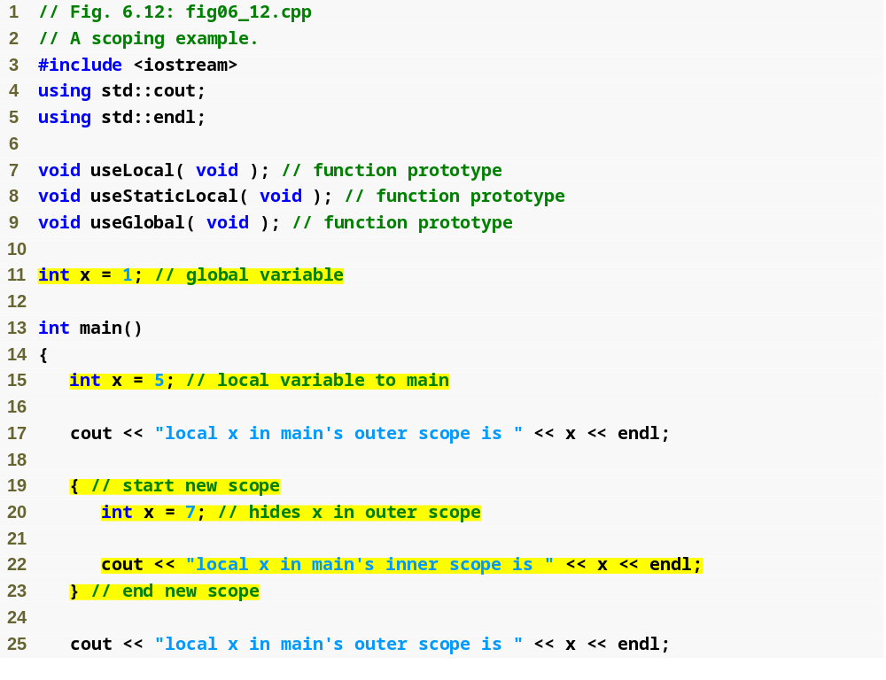
Outline
fig06_12.cpp
(1 of 4)
Declaring a global variable outside any class or function definition
Local variable x that hides global variable x
Local variable x in a block that hides local variable x in outer scope

Slide 49
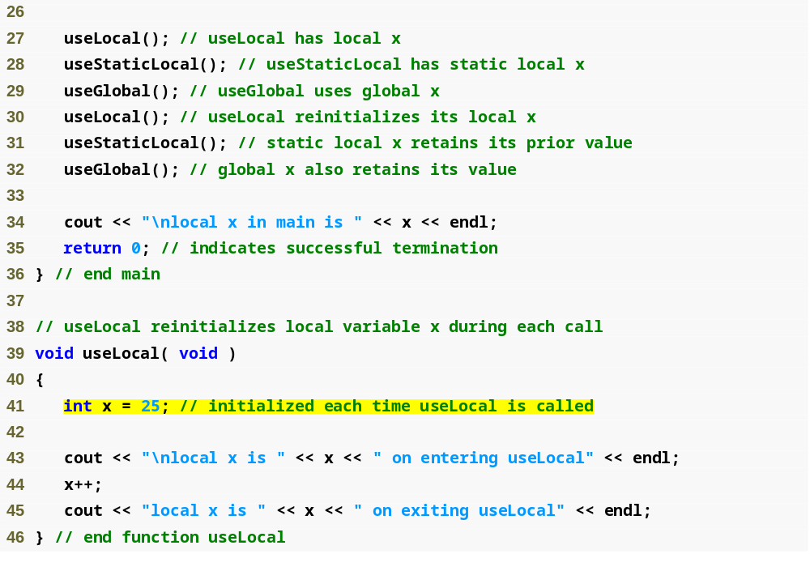
Outline
fig06_12.cpp
(2 of 4)
Local variable that gets recreated and reinitialized each time useLocal is called

Slide 50
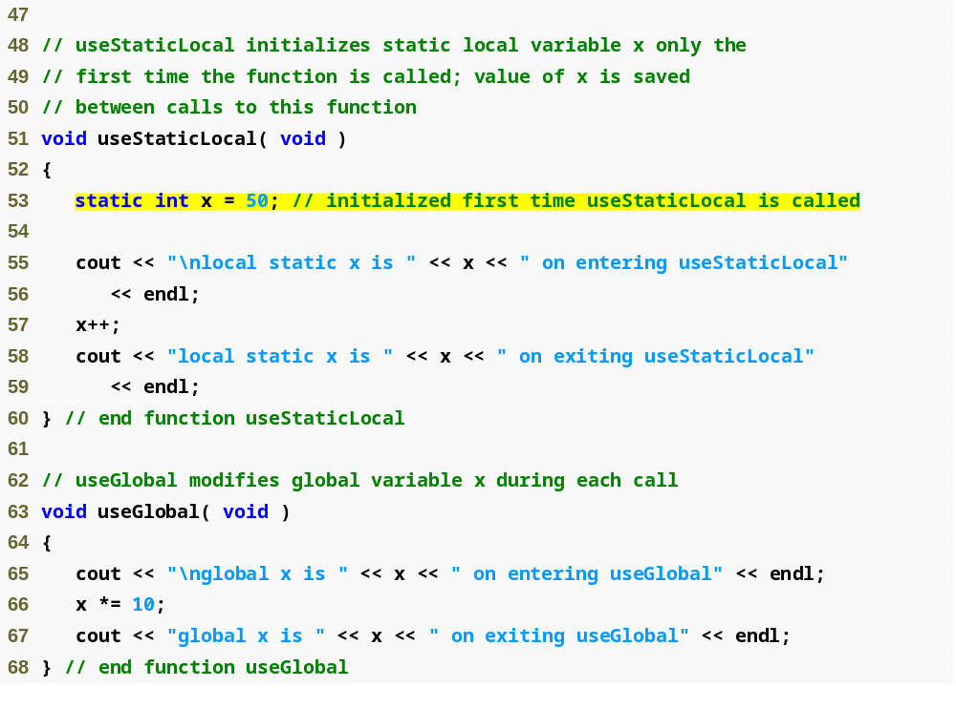
Outline
static local variable that gets initialized only once
fig06_12.cpp
(3 of 4)
Statement refers to global variable x because no local variable named x exists

Slide 51
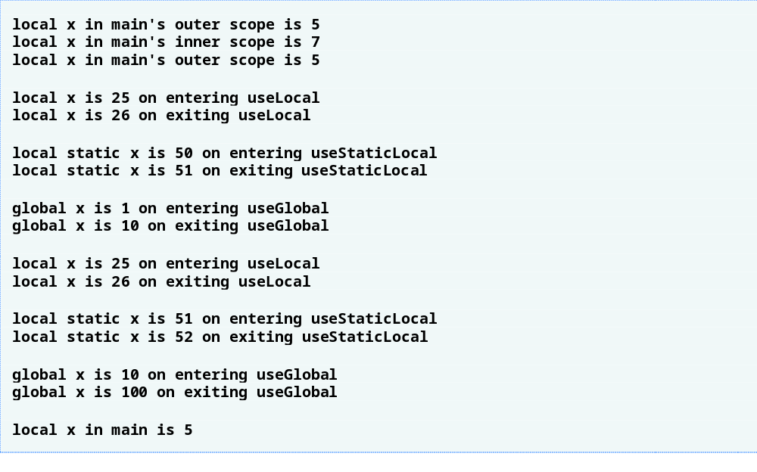
Outline
fig06_12.cpp
(4 of 4)

Slide 52
6.12 Functions with Empty Parameter Lists
Empty parameter list
  Specified by writing either void or nothing at all in parentheses
  For example,
  void print();
  specifies that function print does not take arguments and does not return a value

Slide 53
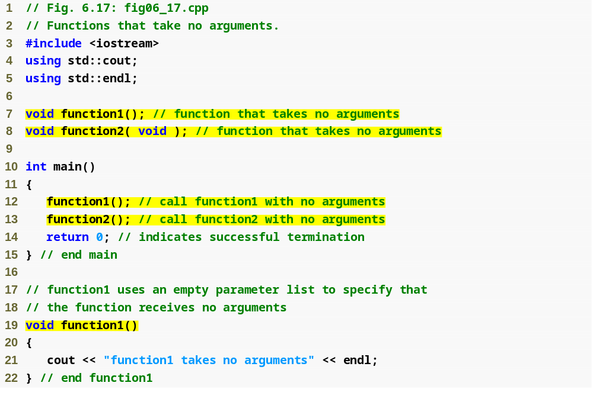
Outline
Specify an empty parameter list by putting nothing in the parentheses
fig06_17.cpp
(1 of 2)
Specify an empty parameter list by putting void in the parentheses

Slide 54
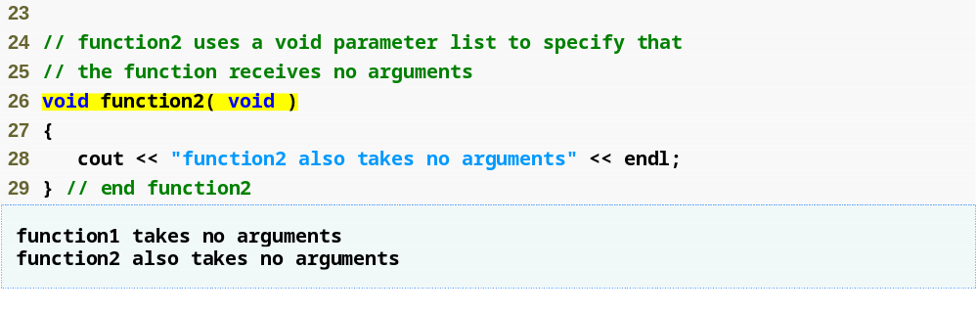
Outline
fig06_17.cpp
(2 of 2)

Slide 55
6.13 Inline Functions
Inline functions
  Reduce function call overhead—especially for small functions
  Qualifier inline before a function’s return type in the function definition
    “Advises” the compiler to generate a copy of the function’s code in place (when appropriate) to avoid a function call
  Trade-off of inline functions
    Multiple copies of the function code are inserted in the program (often making the program larger)
  The compiler can ignore the inline qualifier and typically does so for all but the smallest functions

Slide 56
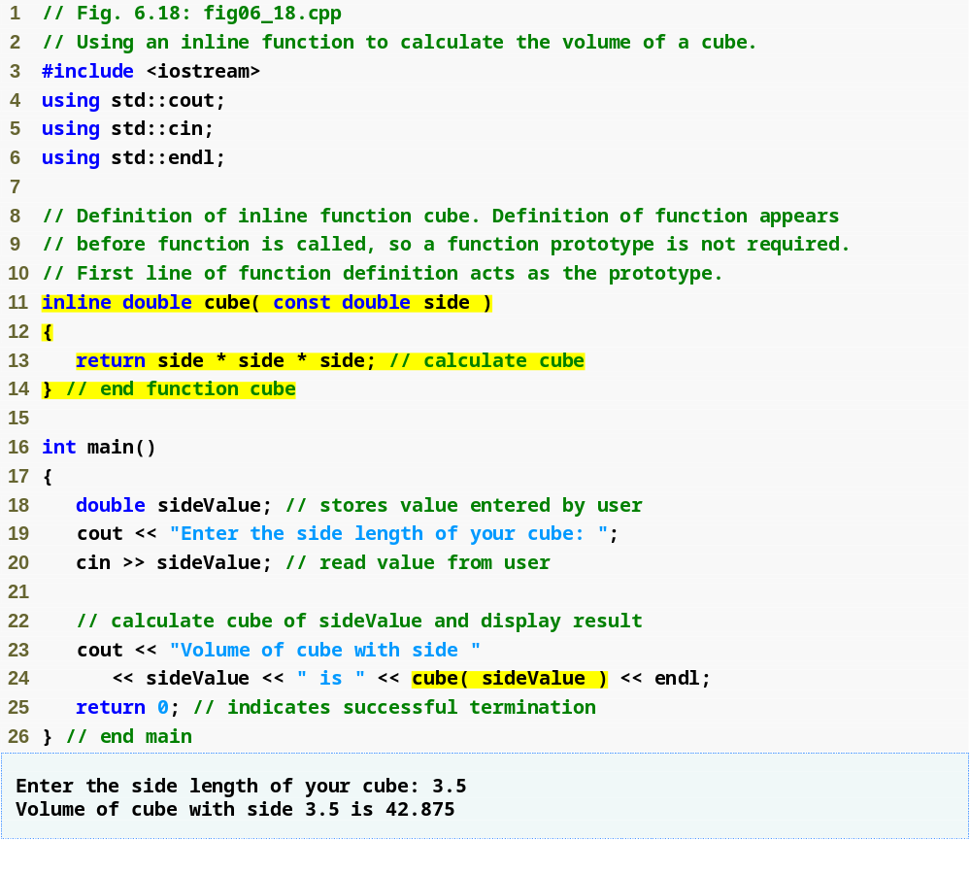
Outline
fig06_18.cpp
(1 of 1)
Complete function definition so the compiler knows how to expand a cube function call into its inlined code.
inline qualifier
cube function call that could be inlined

Slide 57
6.14 References and Reference Parameters
Two ways to pass arguments to functions
  Pass-by-value
    A copy of the argument’s value is passed to the called function
    Changes to the copy do not affect the original variable’s value in the caller
      Prevents accidental side effects of functions
  Pass-by-reference
    Gives called function the ability to access and modify the caller’s argument data directly

Slide 58
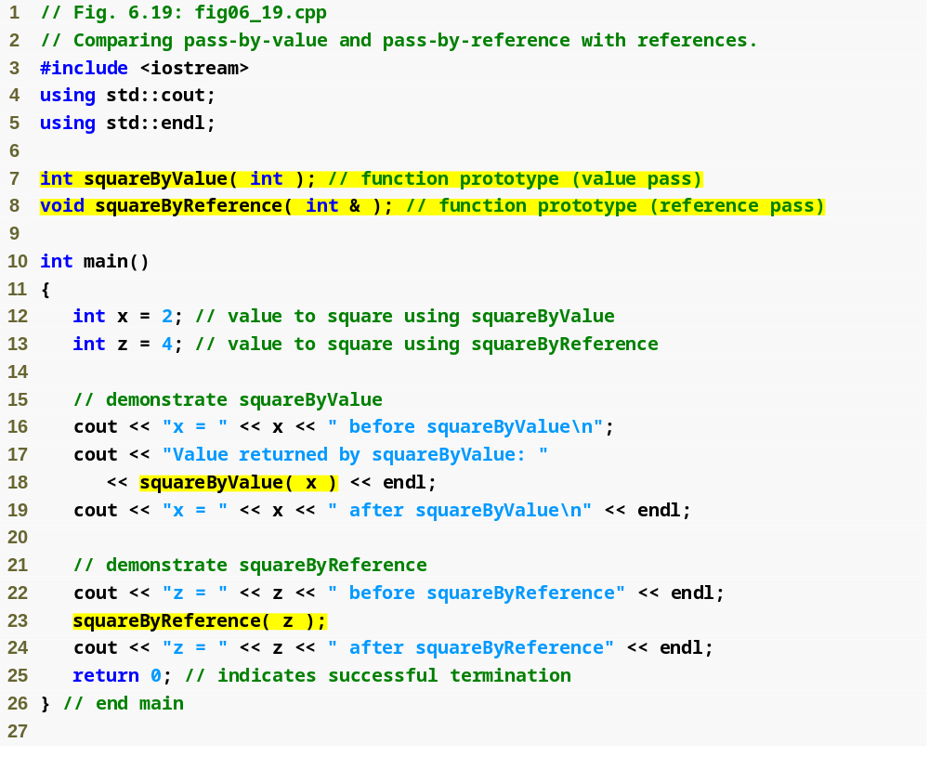
Outline
Function illustrating pass-by-value
fig06_19.cpp
(1 of 2)
Function illustrating pass-by-reference
Variable is simply mentioned by name in both function calls

Slide 59
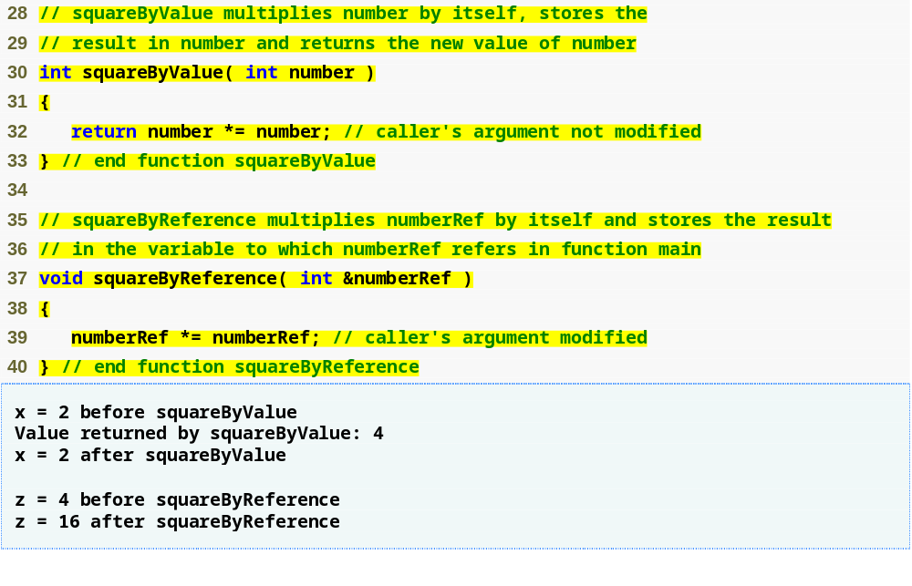
Outline
Receives copy of argument in main
fig06_19.cpp
(2 of 2)
Receives reference to argument in main
Modifies variable in main

Slide 60
6.14 References and Reference Parameters (Cont.)
References
  Can also be used as aliases for other variables within a function
    All operations supposedly performed on the alias (i.e., the reference) are actually performed on the original variable
    An alias is simply another name for the original variable
    Must be initialized in their declarations
      Cannot be reassigned afterward
  Example
    int count = 1;
    int &cRef = count;
    cRef++;
      Increments count through alias cRef

Slide 61
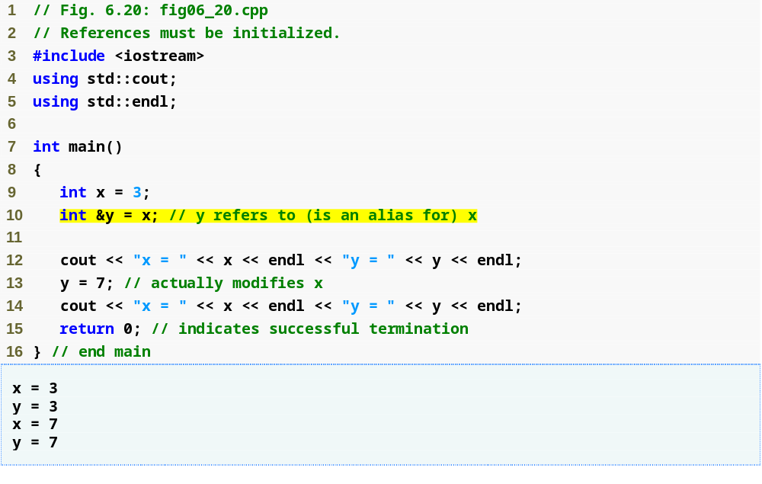
Outline
Creating a reference as an alias to another variable in the function
fig06_20.cpp
(1 of 1)
Assign 7 to x through alias y

Slide 62
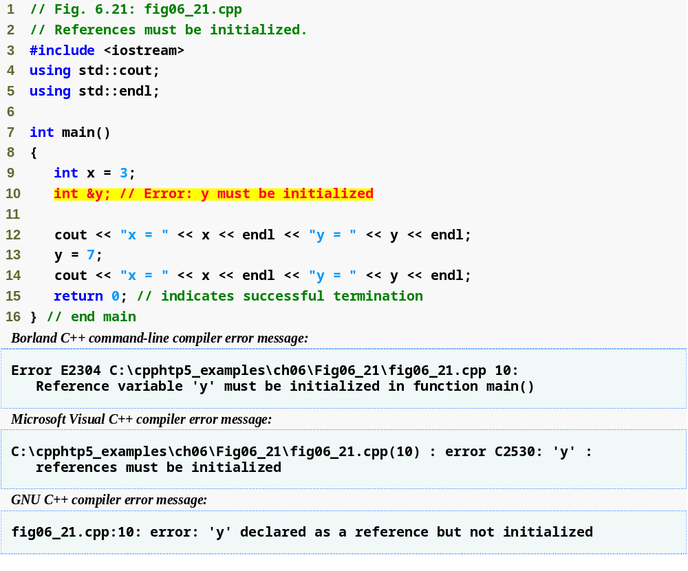
Outline
fig06_21.cpp
(1 of 2)
Uninitialized reference

Slide 63
6.14 References and Reference Parameters (Cont.)
Returning a reference from a function
  Functions can return references to variables
    Should only be used when the variable is static
  Dangling reference
    Returning a reference to an automatic variable
      That variable no longer exists after the function ends

Slide 64
6.15 Default Arguments
Default argument
  A default value to be passed to a parameter
    Used when the function call does not specify an argument for that parameter
  Must be the rightmost argument(s) in a function’s parameter list
  Should be specified with the first occurrence of the function name
    Typically the function prototype

Slide 65
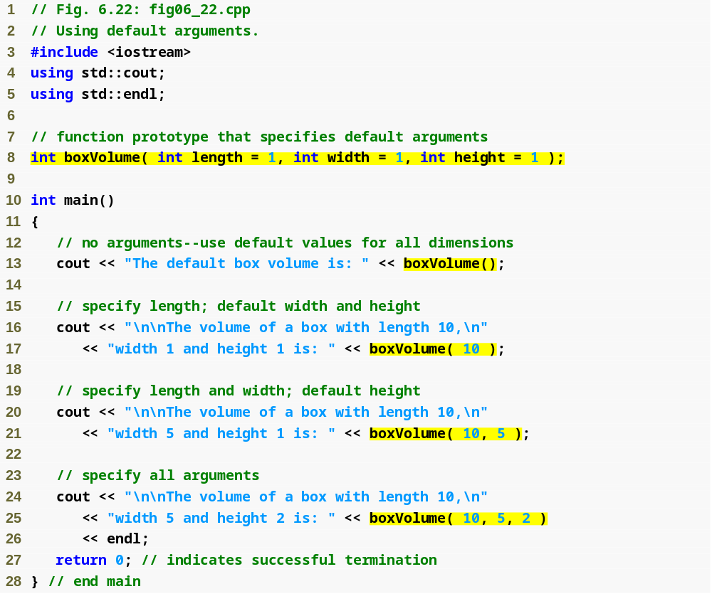
Outline
fig06_22.cpp
(1 of 2)
Default arguments
Calling function with no arguments
Calling function with one argument
Calling function with two arguments
Calling function with three arguments

Slide 66
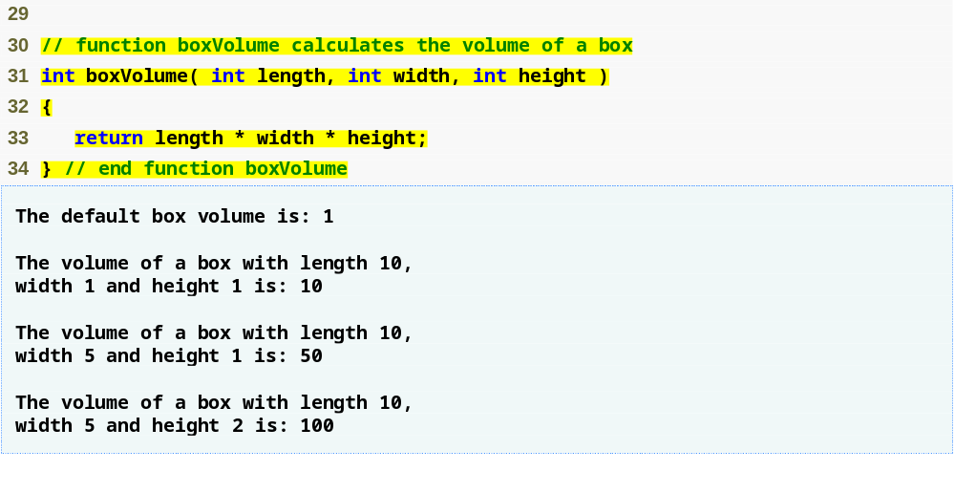
Outline
fig06_22.cpp
(2 of 2)
Note that default arguments were specified in the function prototype, so they are not specified in the function header

Slide 67
6.16 Unary Scope Resolution Operator
Unary scope resolution operator (::)
  Used to access a global variable when a local variable of the same name is in scope
  Cannot be used to access a local variable of the same name in an outer block

Slide 68
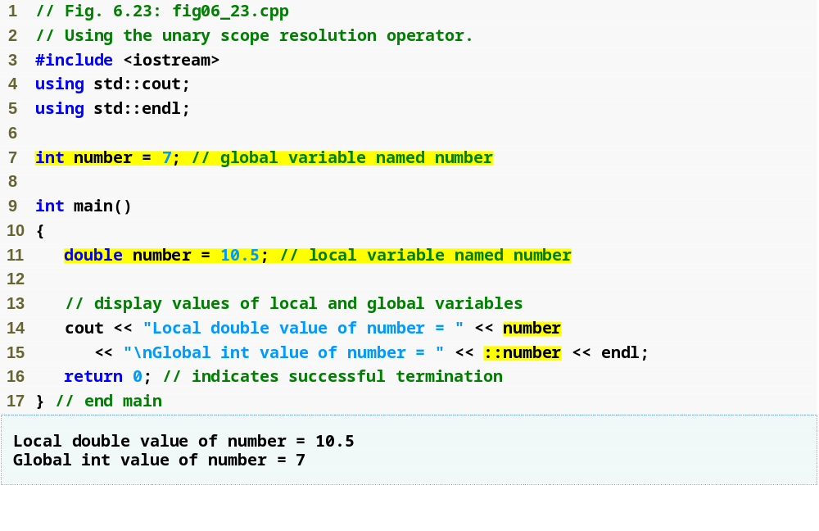
Outline
fig06_23.cpp
(1 of 1)
Unary scope resolution operator used to access global variable number

Slide 69
6.17 Function Overloading
Overloaded functions
  Overloaded functions have
    Same name
    Different sets of parameters
  Compiler selects proper function to execute based on number, types and order of arguments in the function call
  Commonly used to create several functions of the same name that perform similar tasks, but on different data types

Slide 70
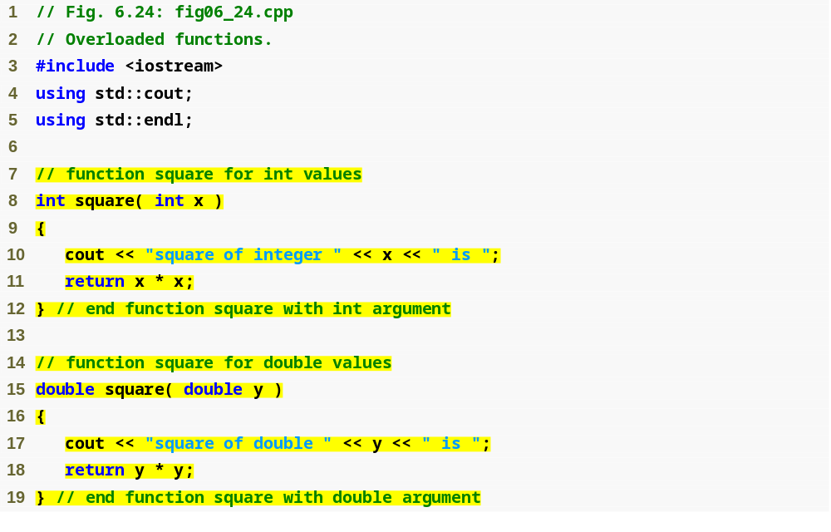
Outline
fig06_24.cpp
(1 of 2)
Defining a square function for ints
Defining a square function for doubles

Slide 71
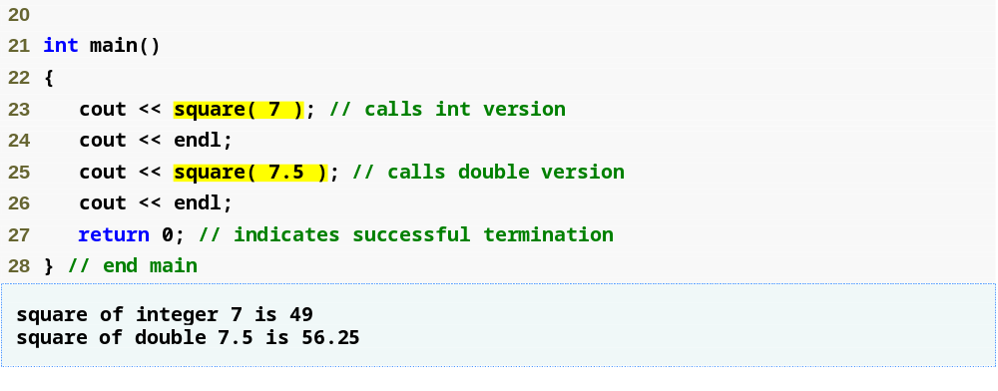
Outline
fig06_24.cpp
(2 of 2)
Output confirms that the proper function was called in each case

Slide 72
6.17 Function Overloading (Cont.)
How the compiler differentiates overloaded functions
  Overloaded functions are distinguished by their signatures
  Name mangling or name decoration
    Compiler encodes each function identifier with the number and types of its parameters to enable type-safe linkage
  Type-safe linkage ensures that
    Proper overloaded function is called
    Types of the arguments conform to types of the parameters

Slide 73
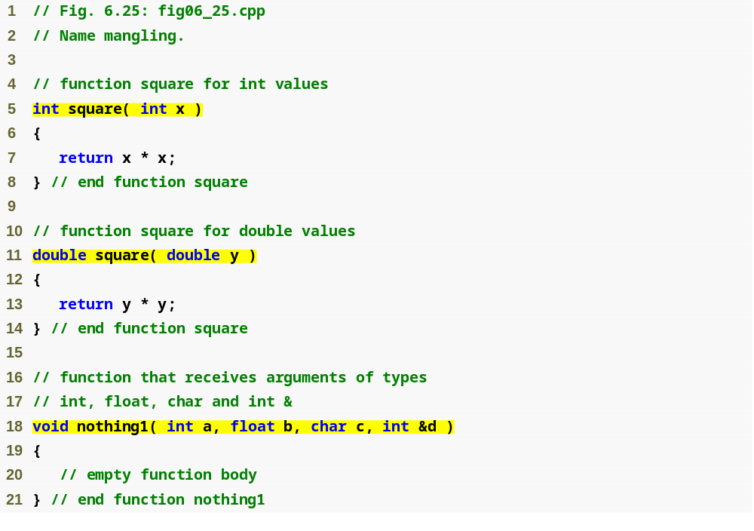
Outline
fig06_25.cpp
(1 of 2)
Overloaded square functions

Slide 74
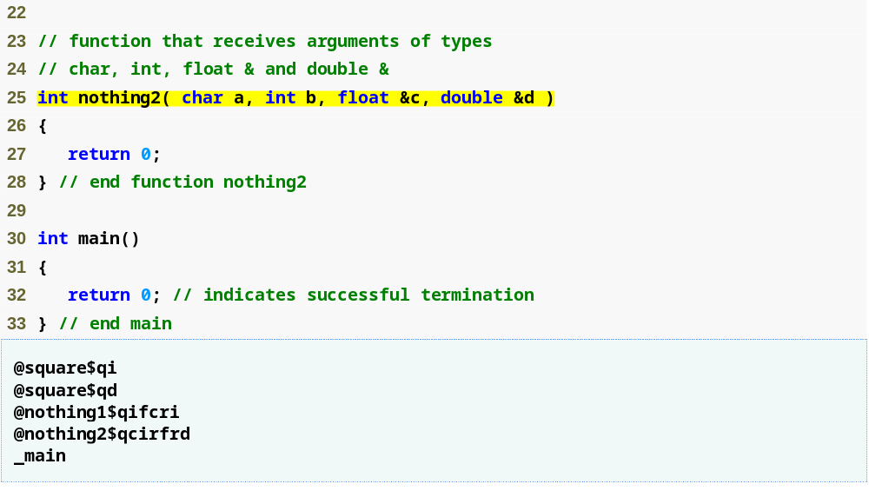
Outline
fig06_25.cpp
(2 of 2)
Mangled names of overloaded functions
main is not mangled because it cannot be overloaded

Slide 75
6.18 Function Templates
Function templates
  More compact and convenient form of overloading
    Identical program logic and operations for each data type
  Function template definition
    Written by programmer once
    Essentially defines a whole family of overloaded functions
    Begins with the template keyword
    Contains template parameter list of formal type parameters for the function template enclosed in angle brackets (<>)
    Formal type parameters
      Preceded by keyword typename or keyword class
      Placeholders for fundamental types or user-defined types

Slide 76
6.18 Function Templates (Cont.)
Function-template specializations
  Generated automatically by the compiler to handle each type of call to the function template
  Example for function template max with type parameter T called with int arguments
    Compiler detects a max invocation in the program code
    int is substituted for T throughout the template definition
    This produces function-template specialization max< int >

Slide 77
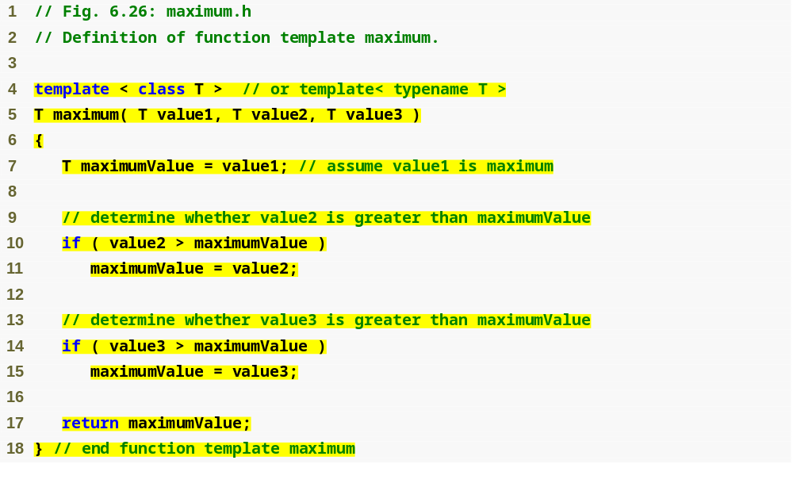
Outline
Using formal type parameter T in place of data type
fig06_26.cpp
(1 of 1)

Slide 78
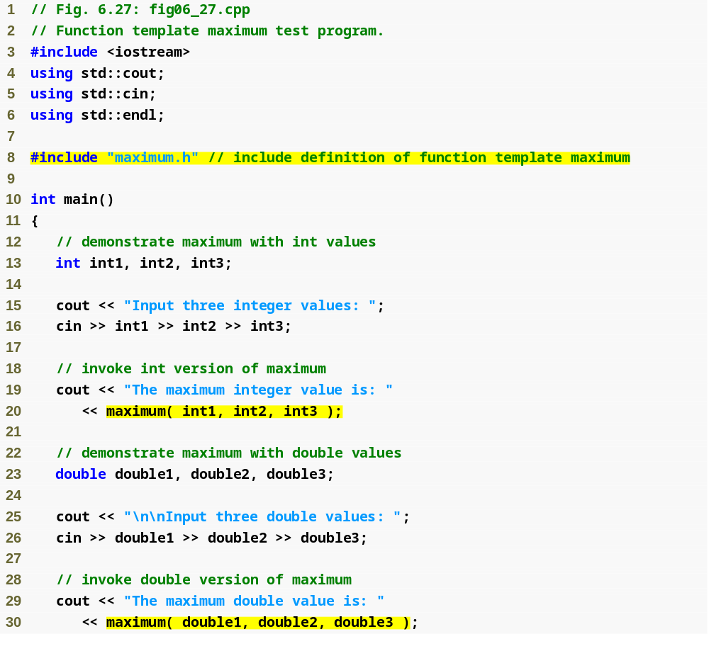
Outline
fig06_27.cpp
(1 of 2)
Invoking maximum with int arguments
Invoking maximum with double arguments

Slide 79
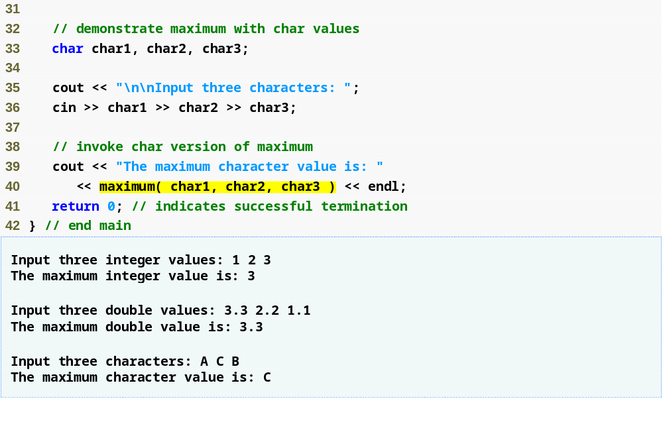
Outline
fig06_27.cpp
(2 of 2)
Invoking maximum with char arguments

